Slide 1

React Fundamentals
Jithin Zacharia
Type to enter a caption.

Slide 2
About Me
Jithin Zacharia
Full Stack Developer @ Infosys
Website - https://jithinqw.github.io/

Slide 3
Agenda
The Javascript elders
What is React ?
Why React ?
Key Fundamentals - V-DOM, React Fiber
React Components
React Props & State
Demo - Writing your React App.
State Management - Introduction to Redux.
Who is using React ?
Writing Mobile Apps using React - React Native
Testing

Slide 4
Why Javascript ?

Slide 5
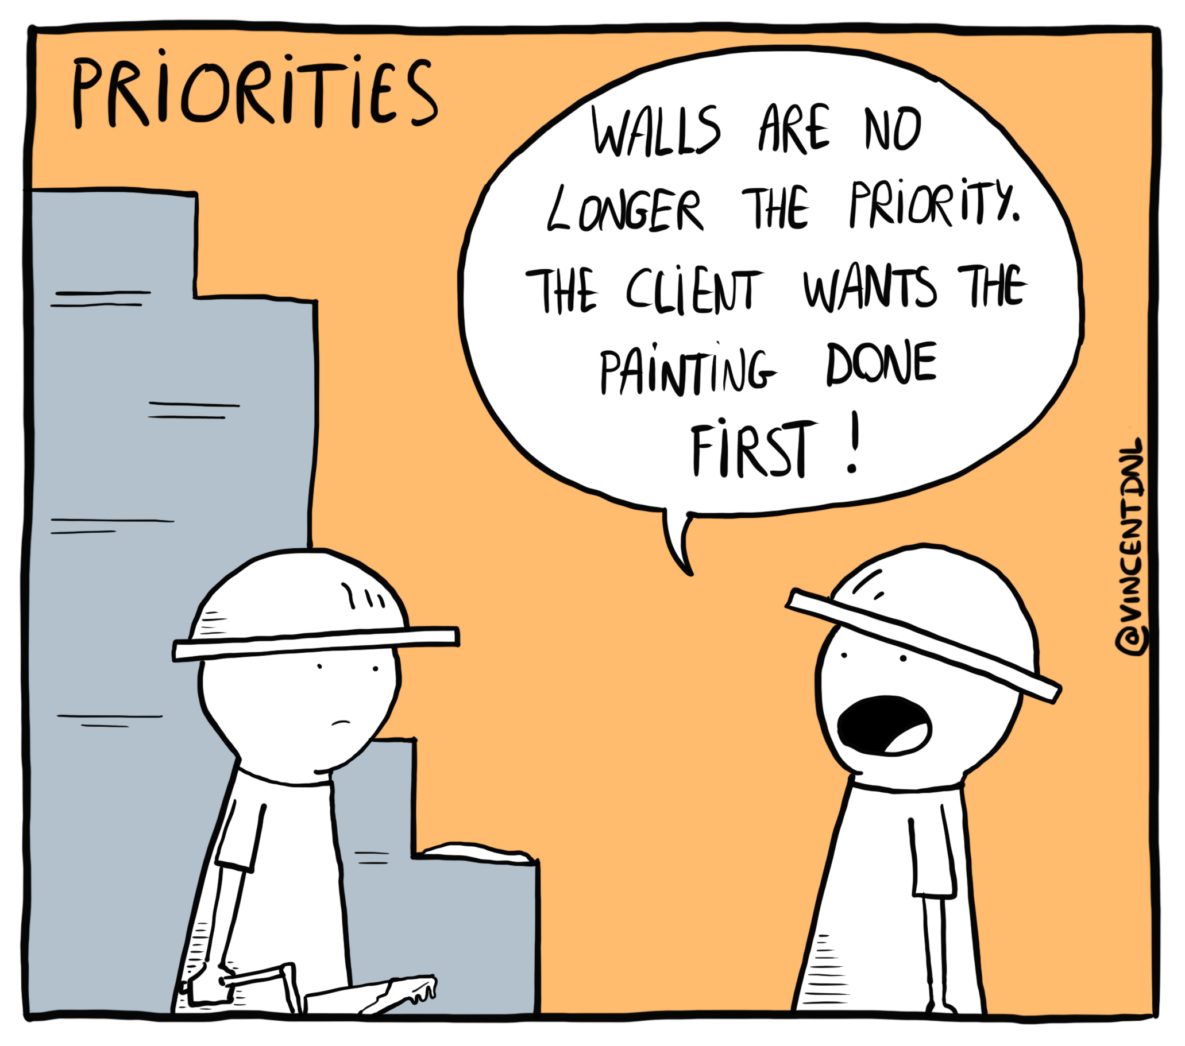

Slide 6

JavaScript Elders

Slide 7
Write less and do more.
AJAX was introduced.
Complex manipulations ? I can do it in back off my head.

Slide 8

AngularJS
Type to enter a caption.

Slide 9
Standing on the shoulders of backend developers
Move your logic to FrontEnd for the first time.
JQuery ? It’ just 1800’s stuff.
Hey what about building and shipping apps ? Do it old style!!! Copy and Paste.

Slide 10

Enter React !
Type to enter a caption.

Slide 11
What is React ?
I am a JavaScript framework developed in 2013 @ Facebook.
I am extremely good at developing visual interfaces.
I split the visual space into components.

Slide 12


Slide 13
Why is React so popular ?
No backward compatibility between Angular 1.x and 2.x
Everyone was working to achieve MVC - I didn’t
Less complex than other frameworks.
Can work anywhere, even SSR!
Less configuration, more speed.

Slide 14
React Fundamentals

Slide 15
Virtual DOM
Converts HTML DOM to a JavaScript Object.
Only needs updates when state changes.
This approach is been used by most of the frameworks.

Slide 16
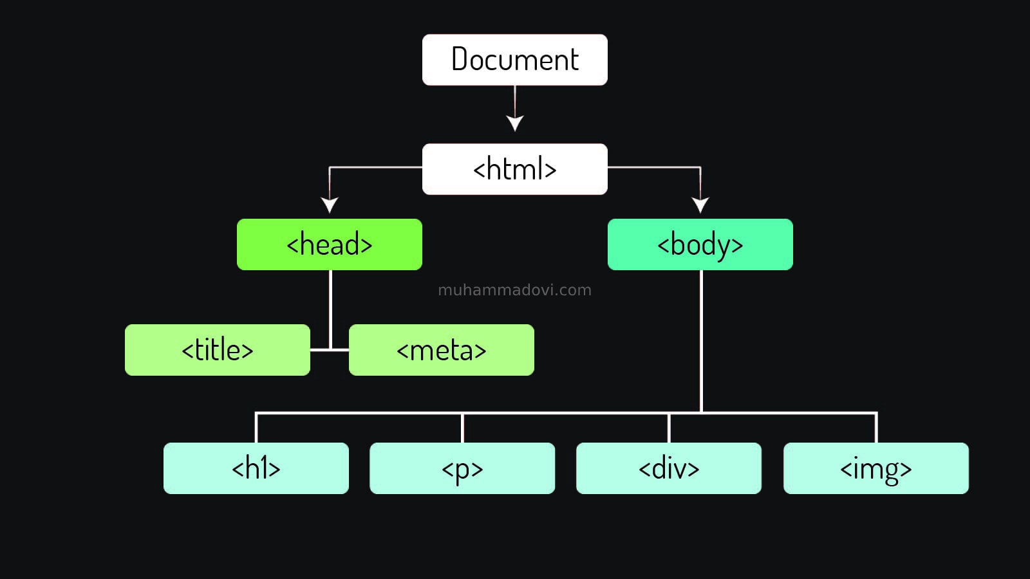

Slide 17
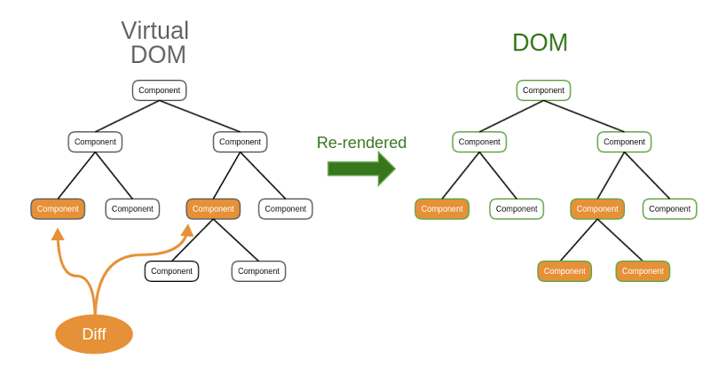

Slide 18
React Fiber
Diffing Algorithm
Finding out which component needs rendering ?
Updating DOM is costly and it’s the soul of React.

Slide 19
React Components
Building block of a React Application.
Each division in React can be a component.
Each component represents a sub-tree in the React Virtual DOM.
Each component is controlled by Props and State.

Slide 20
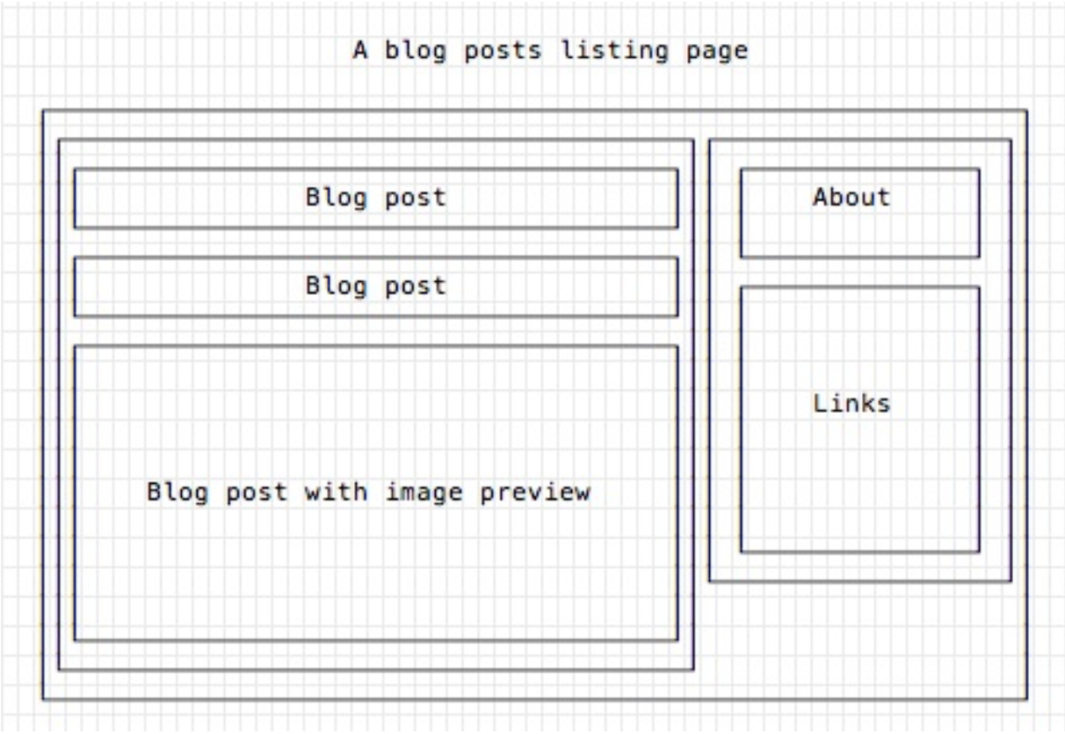

Slide 21
State
State represents data inside a specific component.
Can mutate state using setState function.
State is always uni-directional.
Changing state in one component never changes its parent or its siblings .

Slide 22
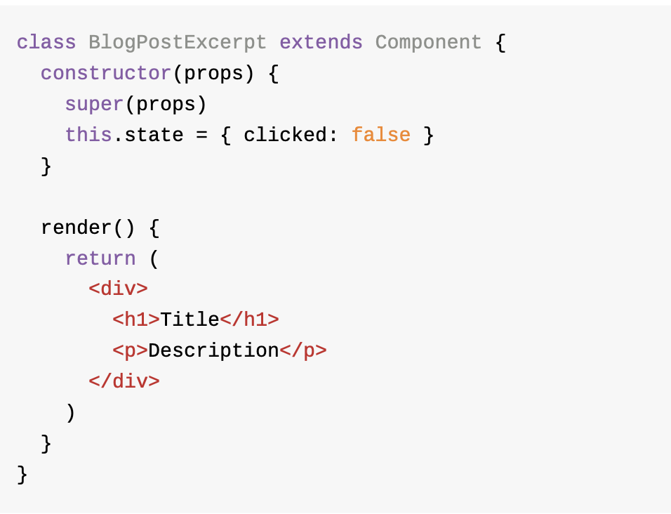

Slide 23
Props
Default properties provided to every component.
Passing props down to child components is a better way to pass data to child components.

Slide 24
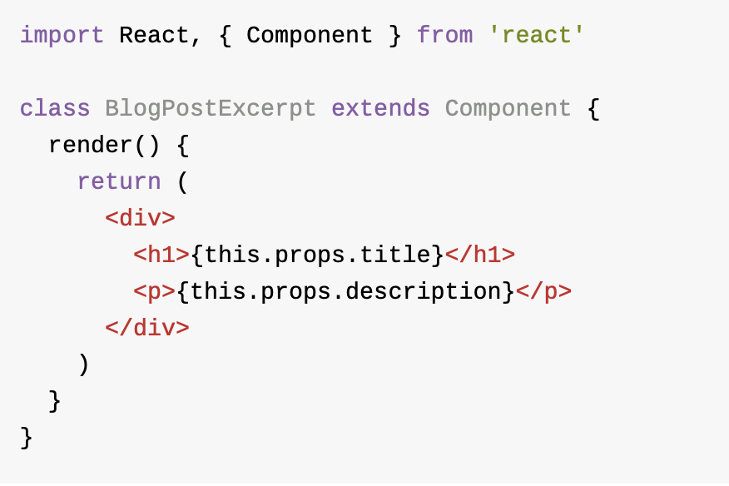

Slide 25
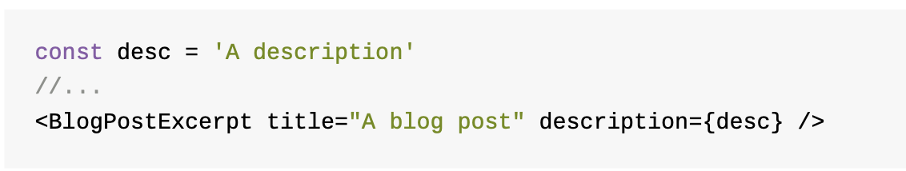

Slide 26
PropTypes
How to make sure that each component is receiving props which are required ?
PropsTypes make a good linting tool for React Application.
Great tool when comes to unit - testing.

Slide 27
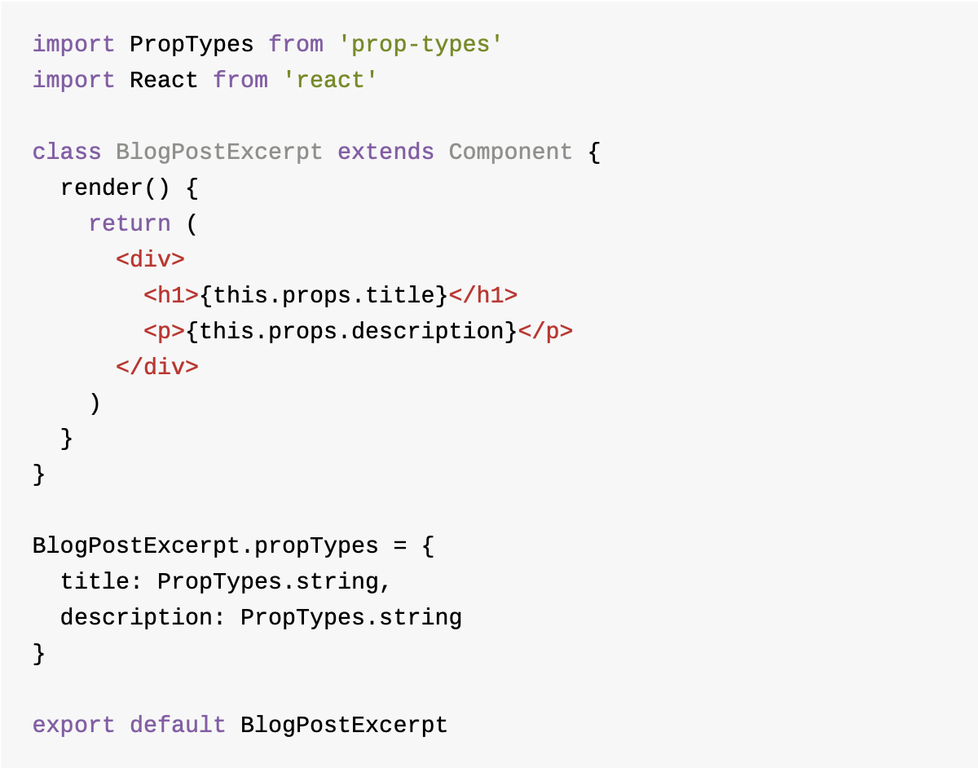

Slide 28
React Events
Since DOM has events, React has to invent its own events.
React events are single queue which listens to user activity .

Slide 29
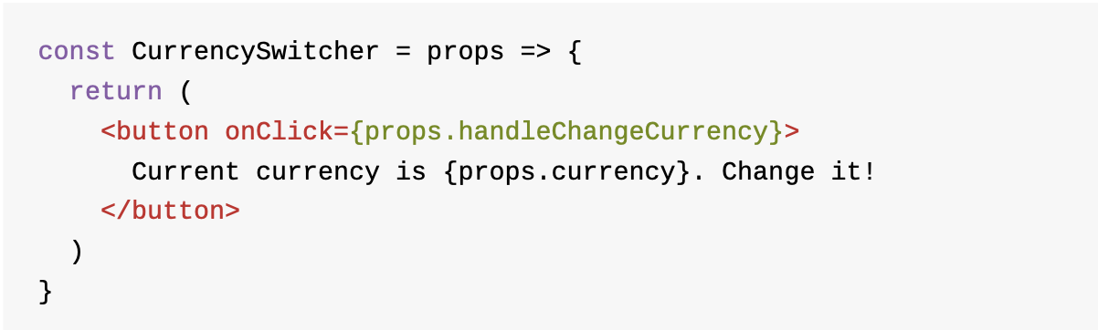

Slide 30
Life-Cycle Events
Maintaining data update on different stages of Component life-cycle.
During these events user can layout management, getting data from a server etc…

Slide 31
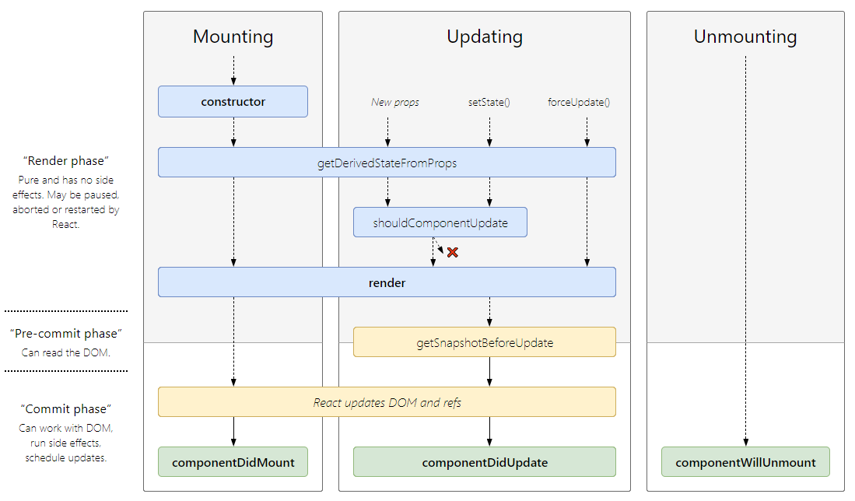

Slide 32
Demo

Slide 33
Managing - State
Why do we need to mange state ?
When to use state management tools ?

Slide 34
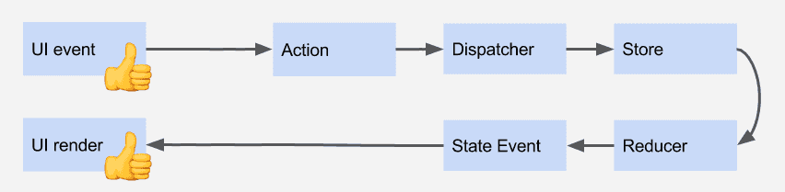
ReduxJS

Slide 35
Popular Libraries
ReduxJS
Flow
Redux Saga
RxJS

Slide 36
Demo

Slide 37
React Native

Slide 38
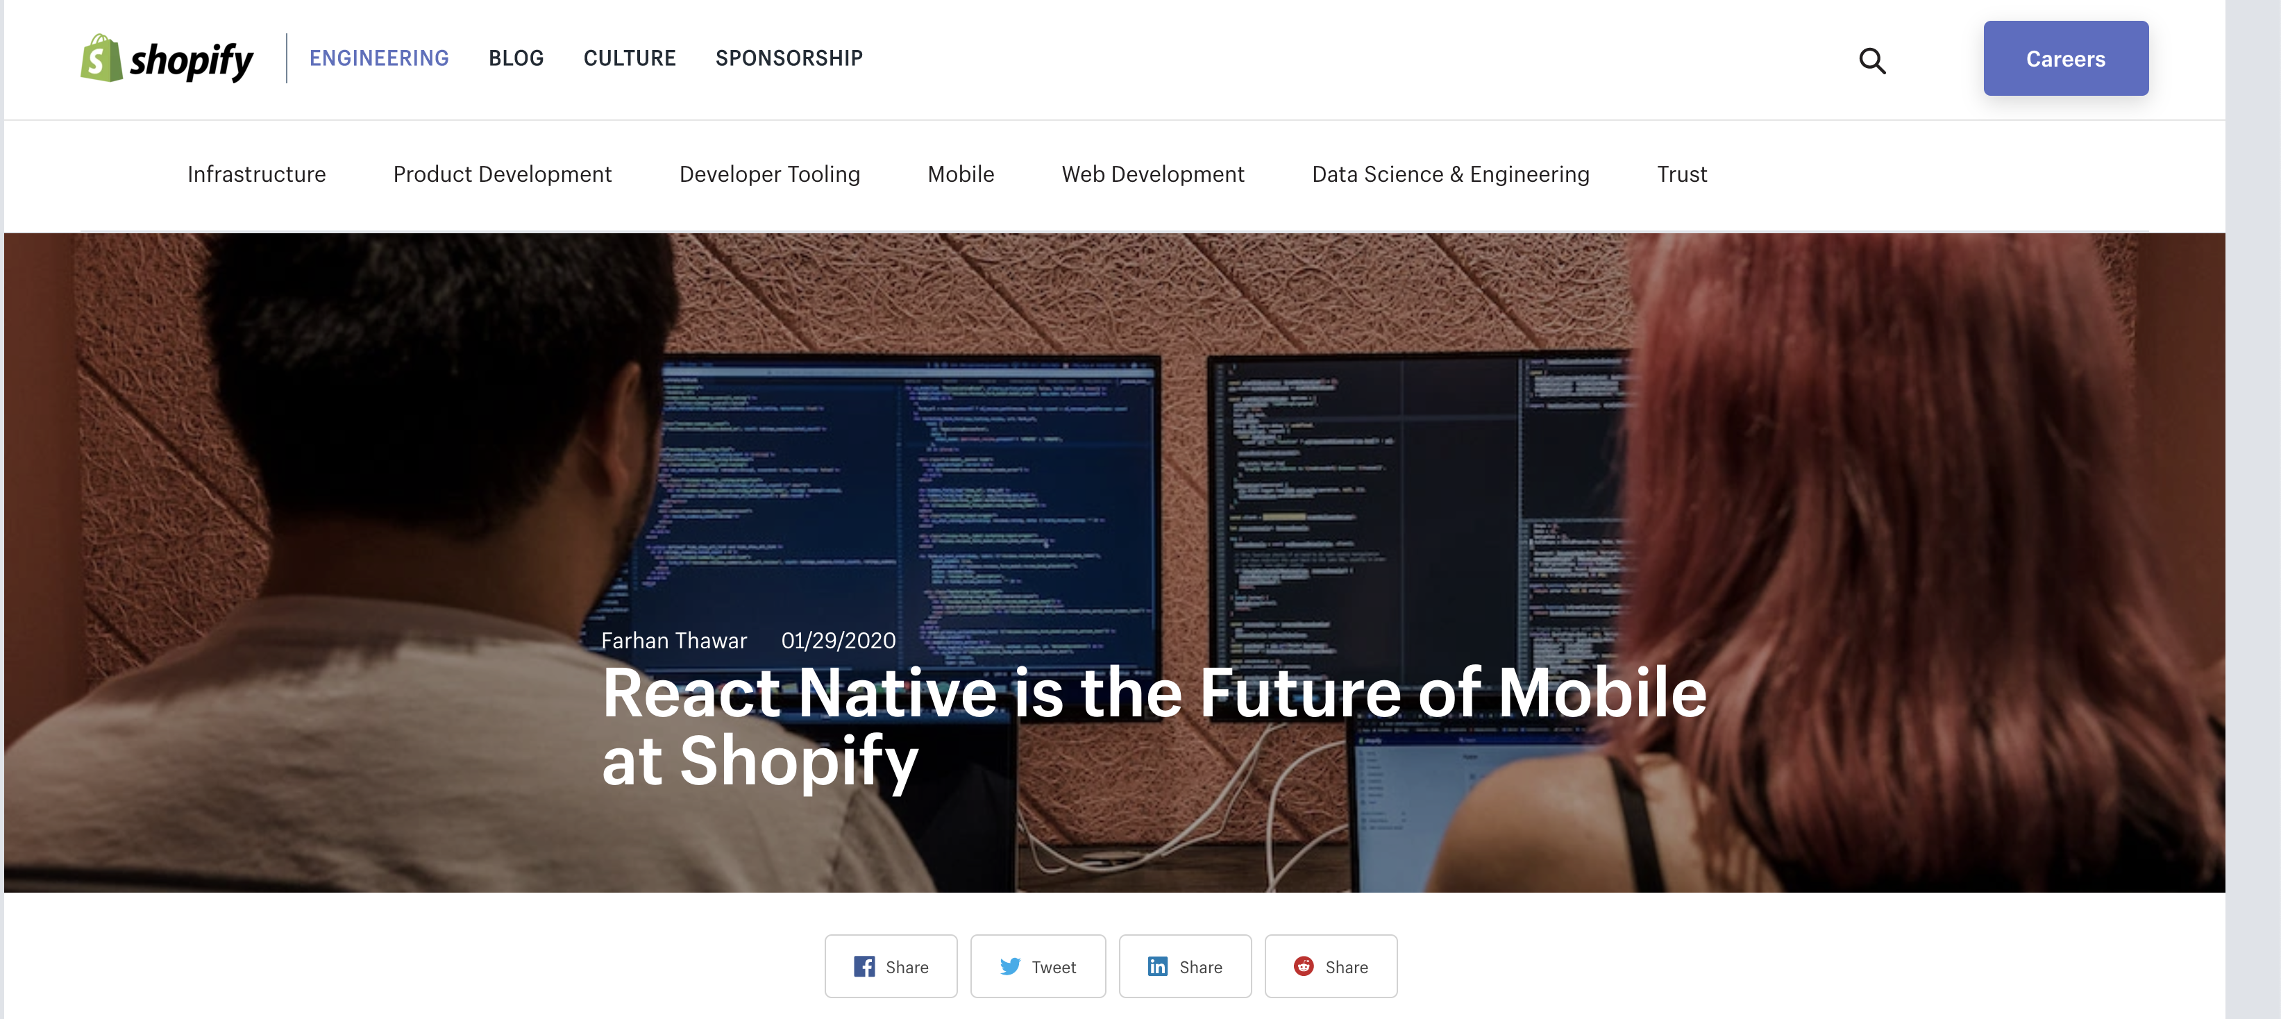

Slide 39
Testing using Jest and Enzyme

Slide 40
What’s next ?
GraphQL
Apollo
NextJS
Svelte
Angular - Ivy and beyond
Creating Native apps using React.
Deno is here !

